Slide 1
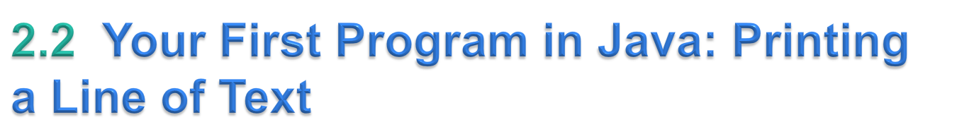
Java application
  A computer program that executes when you use the java command to launch the Java Virtual Machine (JVM).
Sample program in Fig. 2.1 displays a line of text.
© Copyright 1992-2015 by Pearson Education, Inc. All Rights Reserved.

Slide 2
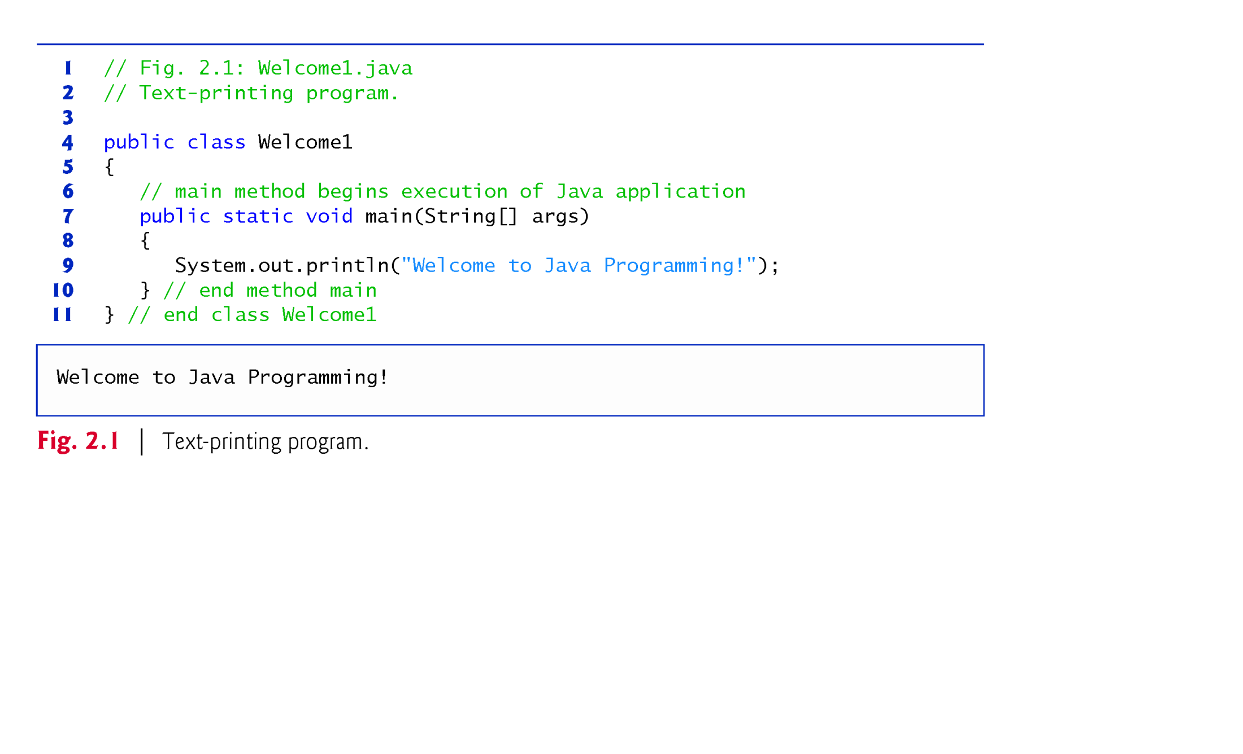
© Copyright 1992-2015 by Pearson Education, Inc. All Rights Reserved.

Slide 3
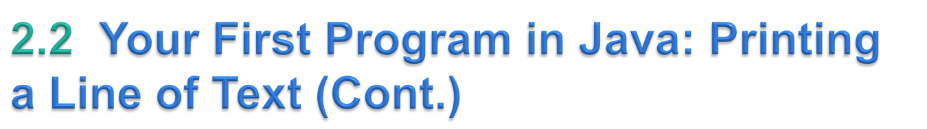
Declaring a class
Class declaration
    public class Welcome1
  Every Java program consists of at least one class that you define.
  class keyword introduces a class declaration and is immediately followed by the class name.
  Keywords (Appendix C) are reserved for use by Java and are always spelled with all lowercase letters.
© Copyright 1992-2015 by Pearson Education, Inc. All Rights Reserved.

Slide 4
Class Body
A left brace, {, begins the body of every class declaration.
A corresponding right brace, }, must end each class declaration.
© Copyright 1992-2015 by Pearson Education, Inc. All Rights Reserved.

Slide 5
Using Blank Lines
Blank lines, space characters and tabs
  Make programs easier to read.
  Together, they’re known as white space (or whitespace).
  White space is ignored by the compiler.
© Copyright 1992-2015 by Pearson Education, Inc. All Rights Reserved.

Slide 6
Declaring a Method
  public static void main( String[] args )
Starting point of every Java application.
Parentheses after the identifier main indicate that it’s a program building block called a method.
Java class declarations normally contain one or more methods.
main must be defined as shown; otherwise, the JVM will not execute the application.
Methods perform tasks and can return information when they complete their tasks.
Keyword void indicates that this method will not return any information.
© Copyright 1992-2015 by Pearson Education, Inc. All Rights Reserved.

Slide 7
Body of the method declaration
  Enclosed in left and right braces.
Statement
    System.out.println("Welcome to Java Programming!");
  Instructs the computer to perform an action
    Display the characters contained between the double quotation marks.
  Together, the quotation marks and the characters between them are a string—also known as a character string or a string literal.
  White-space characters in strings are not ignored by the compiler.
  Strings cannot span multiple lines of code.
© Copyright 1992-2015 by Pearson Education, Inc. All Rights Reserved.

Slide 8
System.out object
  Standard output object.
  Allows a Java application to display information in the command window from which it executes.
System.out.println method
  Displays (or prints) a line of text in the command window.
  The string in the parentheses the argument to the method.
  Positions the output cursor at the beginning of the next line in the command window.
Most statements end with a semicolon.
© Copyright 1992-2015 by Pearson Education, Inc. All Rights Reserved.

Slide 9
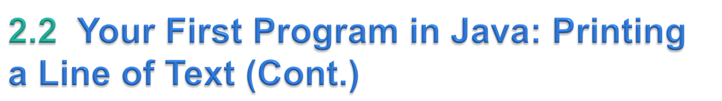
Commenting Your Programs
Comments
    // Fig. 2.1: Welcome1.java
  // indicates that the line is a comment.
  Used to document programs and improve their readability.
  Compiler ignores comments.
  A comment that begins with // is an end-of-line comment—it terminates at the end of the line on which it appears.
Traditional comment, can be spread over several lines as in
    /* This is a traditional comment. It
    can be split over multiple lines */
  This type of comment begins with /* and ends with */.
  All text between the delimiters is ignored by the compiler.
© Copyright 1992-2015 by Pearson Education, Inc. All Rights Reserved.

Slide 10

Class Welcome2, shown in Fig. 2.3, uses two statements to produce the same output as that shown in Fig. 2.1.
New and key features in each code listing are highlighted.
System.out’s method print displays a string.
Unlike println, print does not position the output cursor at the beginning of the next line in the command window.
  The next character the program displays will appear immediately after the last character that print displays.
© Copyright 1992-2015 by Pearson Education, Inc. All Rights Reserved.

Slide 11
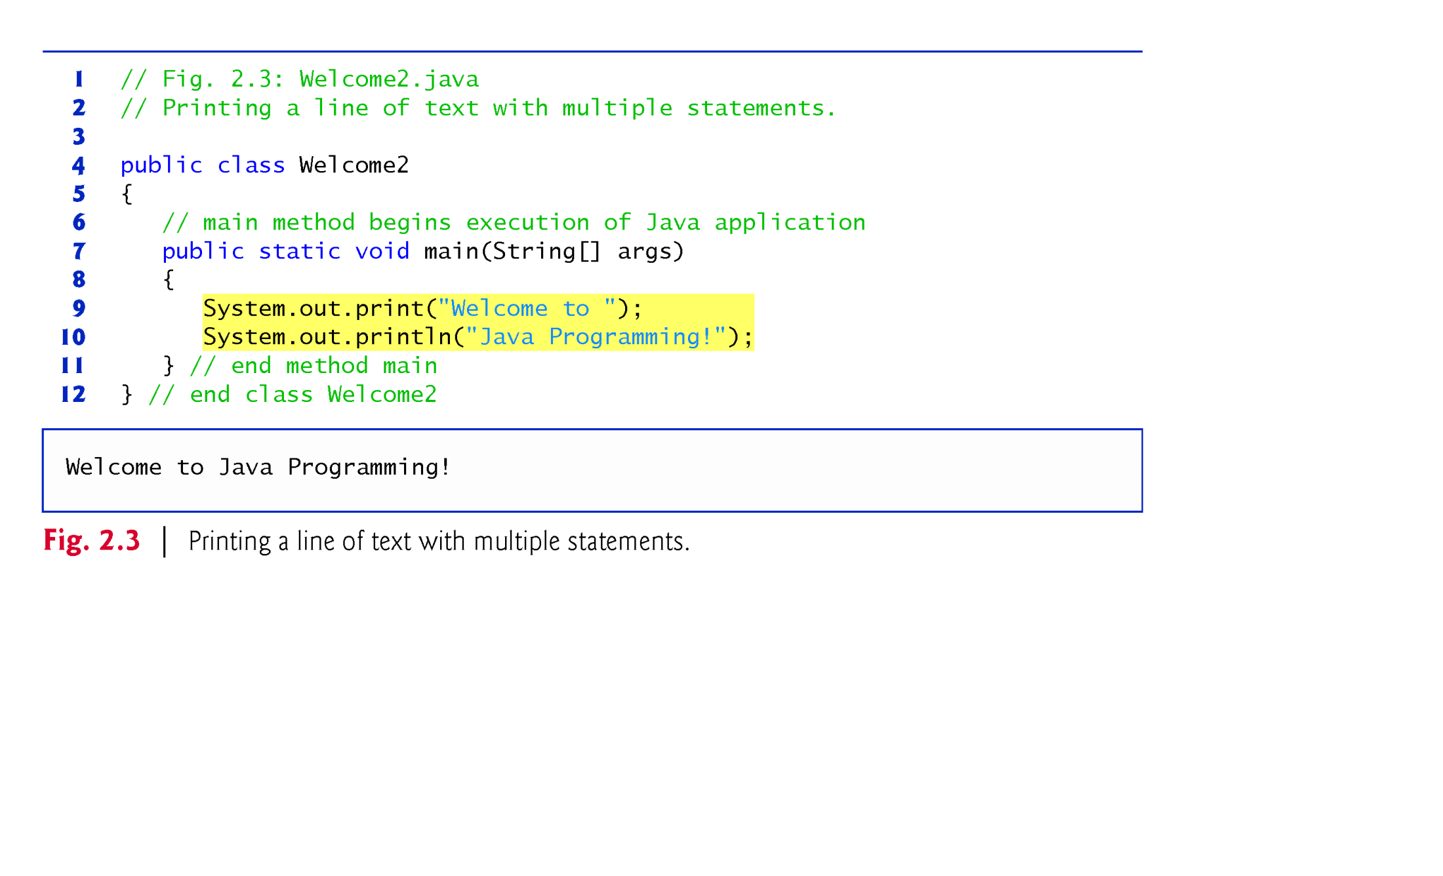
© Copyright 1992-2015 by Pearson Education, Inc. All Rights Reserved.

Slide 12
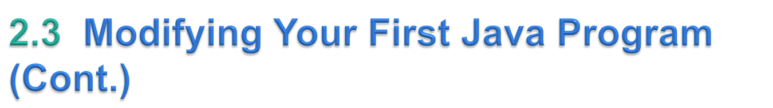
Newline characters indicate to System.out’s print and println methods when to position the output cursor at the beginning of the next line in the command window.
Newline characters are whitespace characters.
The backslash (\) is called an escape character.
  Indicates a “special character”
Backslash is combined with the next character to form an escape sequence—\n represents the newline character.
Complete list of escape sequences
    http://docs.oracle.com/javase/specs/jls/se7/html/
    jls-3.html#jls-3.10.6.
© Copyright 1992-2015 by Pearson Education, Inc. All Rights Reserved.

Slide 13
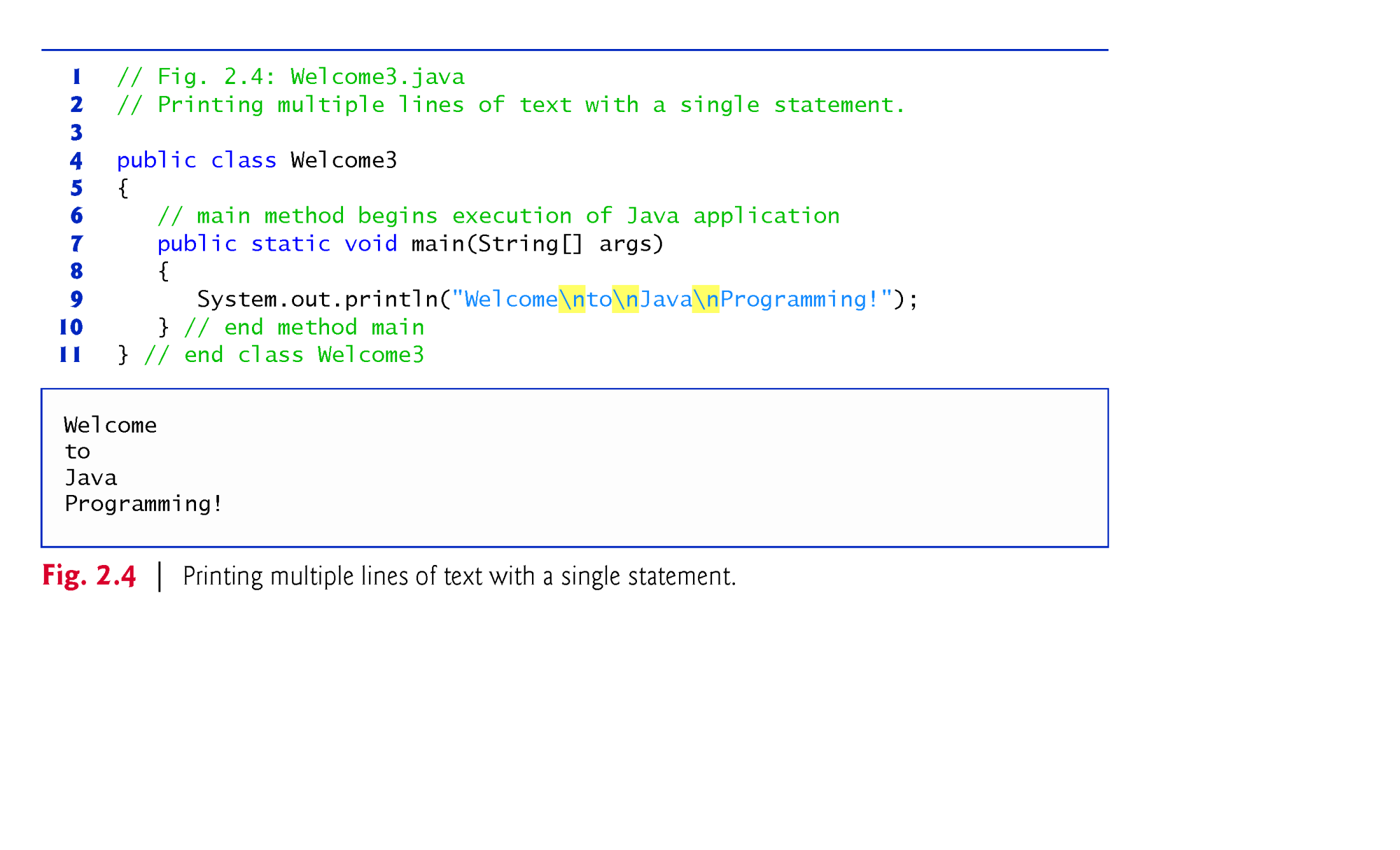
© Copyright 1992-2015 by Pearson Education, Inc. All Rights Reserved.

Slide 14
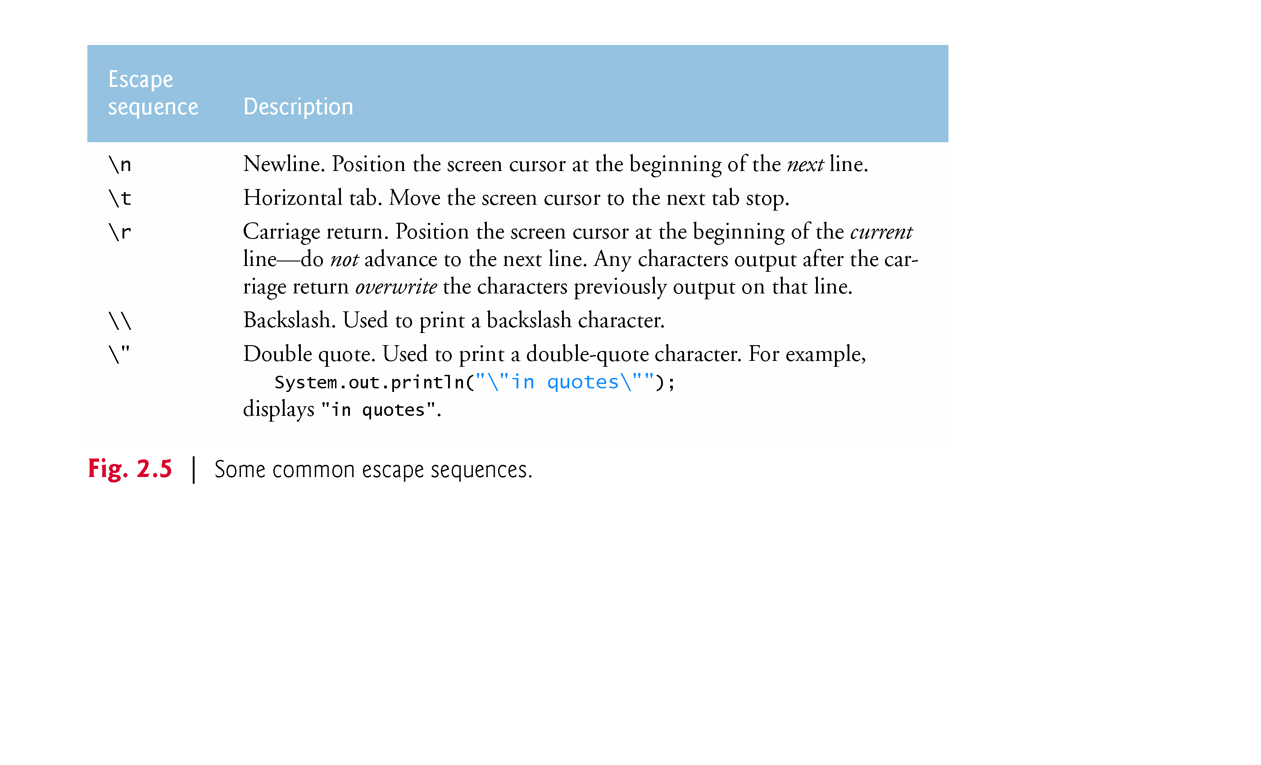
© Copyright 1992-2015 by Pearson Education, Inc. All Rights Reserved.

Slide 15

System.out.printf method
  f means “formatted”
  displays formatted data
Multiple method arguments are placed in a comma-separated list.
Calling a method is also referred to as invoking a method.
Java allows large statements to be split over many lines.
  Cannot split a statement in the middle of an identifier or string.
Method printf’s first argument is a format string
  May consist of fixed text and format specifiers.
  Fixed text is output as it would be by print or println.
  Each format specifier is a placeholder for a value and specifies the type of data to output.
Format specifiers begin with a percent sign (%) and are followed by a character that represents the data type.
Format specifier %s is a placeholder for a string.
© Copyright 1992-2015 by Pearson Education, Inc. All Rights Reserved.

Slide 16
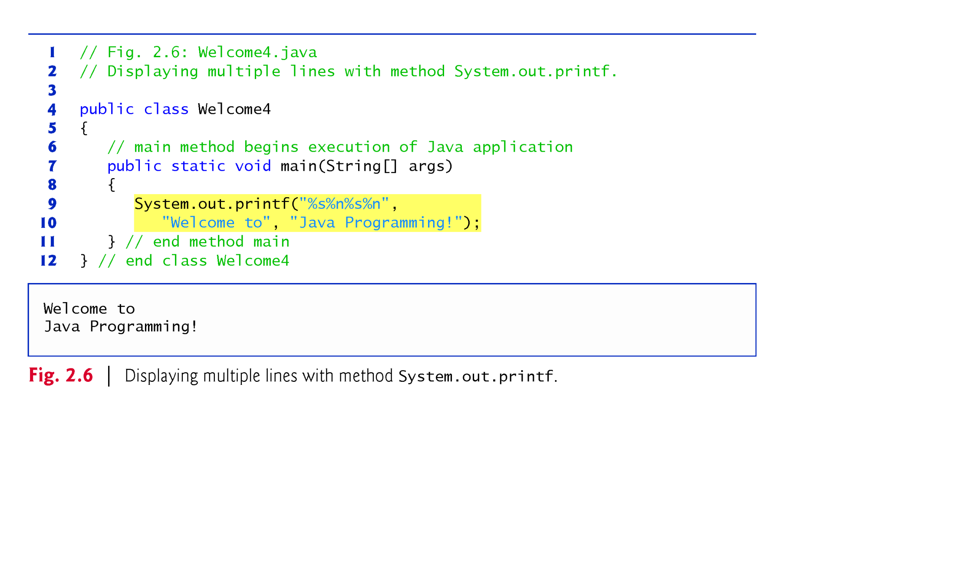
© Copyright 1992-2015 by Pearson Education, Inc. All Rights Reserved.

Slide 17

Integers
  Whole numbers, like –22, 7, 0 and 1024)
Programs remember numbers and other data in the computer’s memory and access that data through program elements called variables.
The program of Fig. 2.7 demonstrates these concepts.
© Copyright 1992-2015 by Pearson Education, Inc. All Rights Reserved.

Slide 18

Helps the compiler locate a class that is used in this program.
Rich set of predefined classes that you can reuse rather than “reinventing the wheel.”
Classes are grouped into packages—named groups of related classes—and are collectively referred to as the Java class library, or the Java Application Programming Interface (Java API).
You use import declarations to identify the predefined classes used in a Java program.
© Copyright 1992-2015 by Pearson Education, Inc. All Rights Reserved.

Slide 19
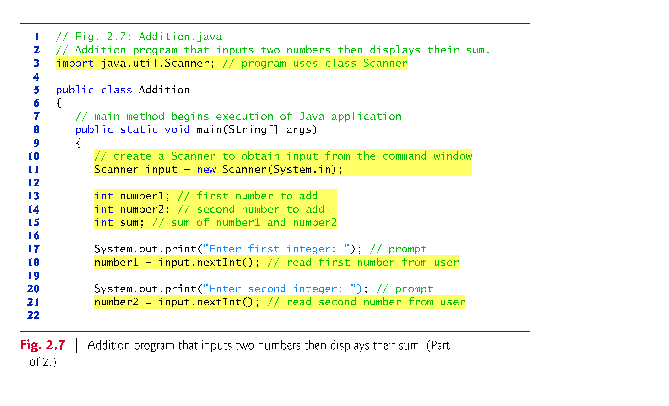
© Copyright 1992-2015 by Pearson Education, Inc. All Rights Reserved.

Slide 20
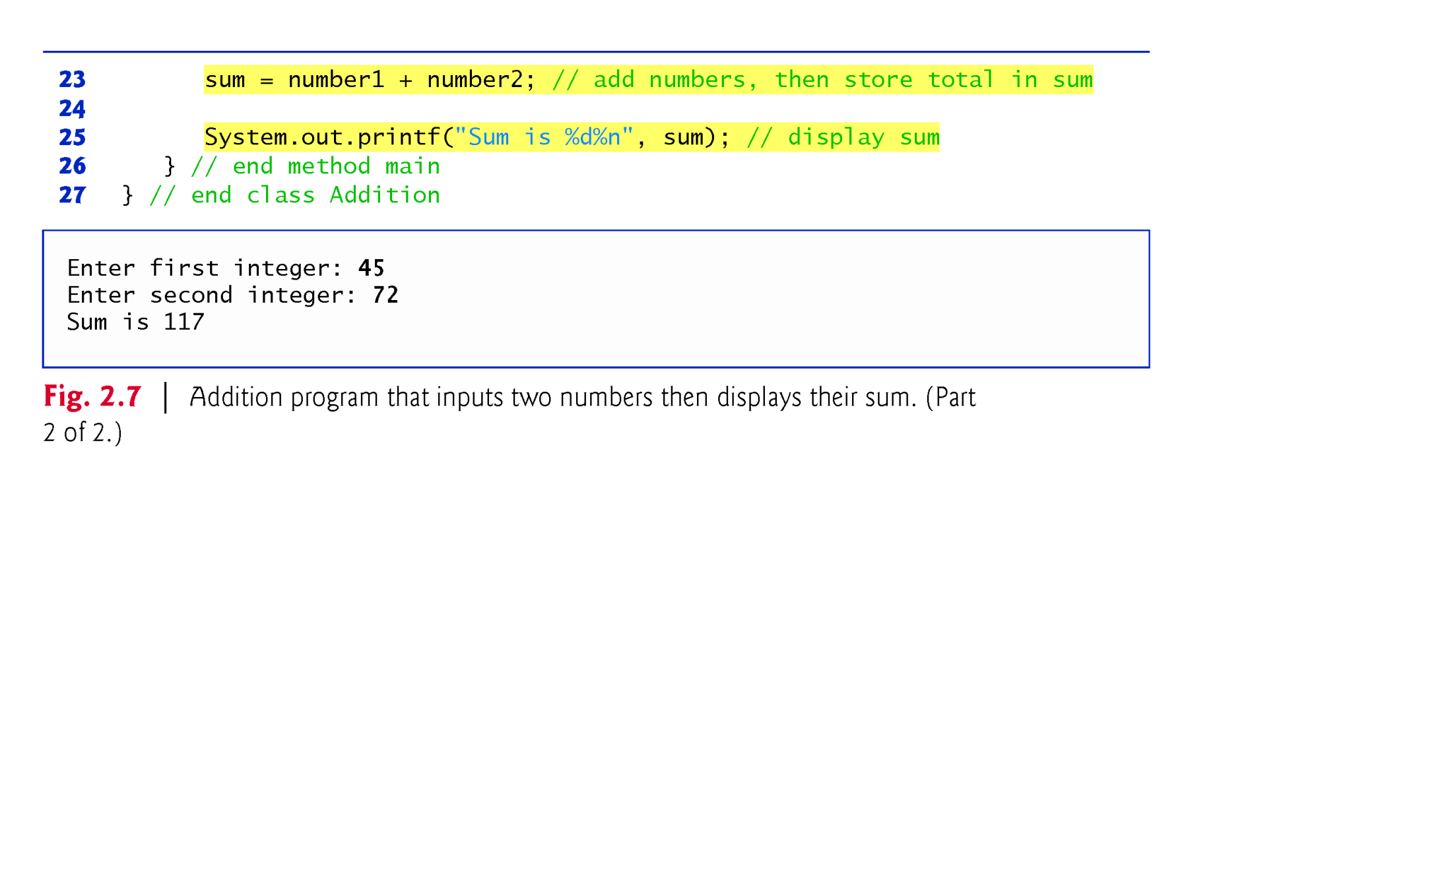
© Copyright 1992-2015 by Pearson Education, Inc. All Rights Reserved.

Slide 21

Arithmetic operators are summarized in Fig. 2.11.
The asterisk (*) indicates multiplication
The percent sign (%) is the remainder operator
The arithmetic operators are binary operators because they each operate on two operands.
Integer division yields an integer quotient.
  Any fractional part in integer division is simply truncated (i.e., discarded)—no rounding occurs.
The remainder operator, %, yields the remainder after division.
© Copyright 1992-2015 by Pearson Education, Inc. All Rights Reserved.

Slide 22
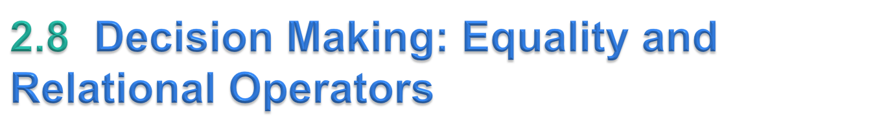
Condition
  An expression that can be true or false.
if selection statement
  Allows a program to make a decision based on a condition’s value.
Equality operators (== and !=)
Relational operators (>, <, >= and <=)
Both equality operators have the same level of precedence, which is lower than that of the relational operators.
The equality operators associate from left to right.
The relational operators all have the same level of precedence and also associate from left to right.
© Copyright 1992-2015 by Pearson Education, Inc. All Rights Reserved.

Slide 23
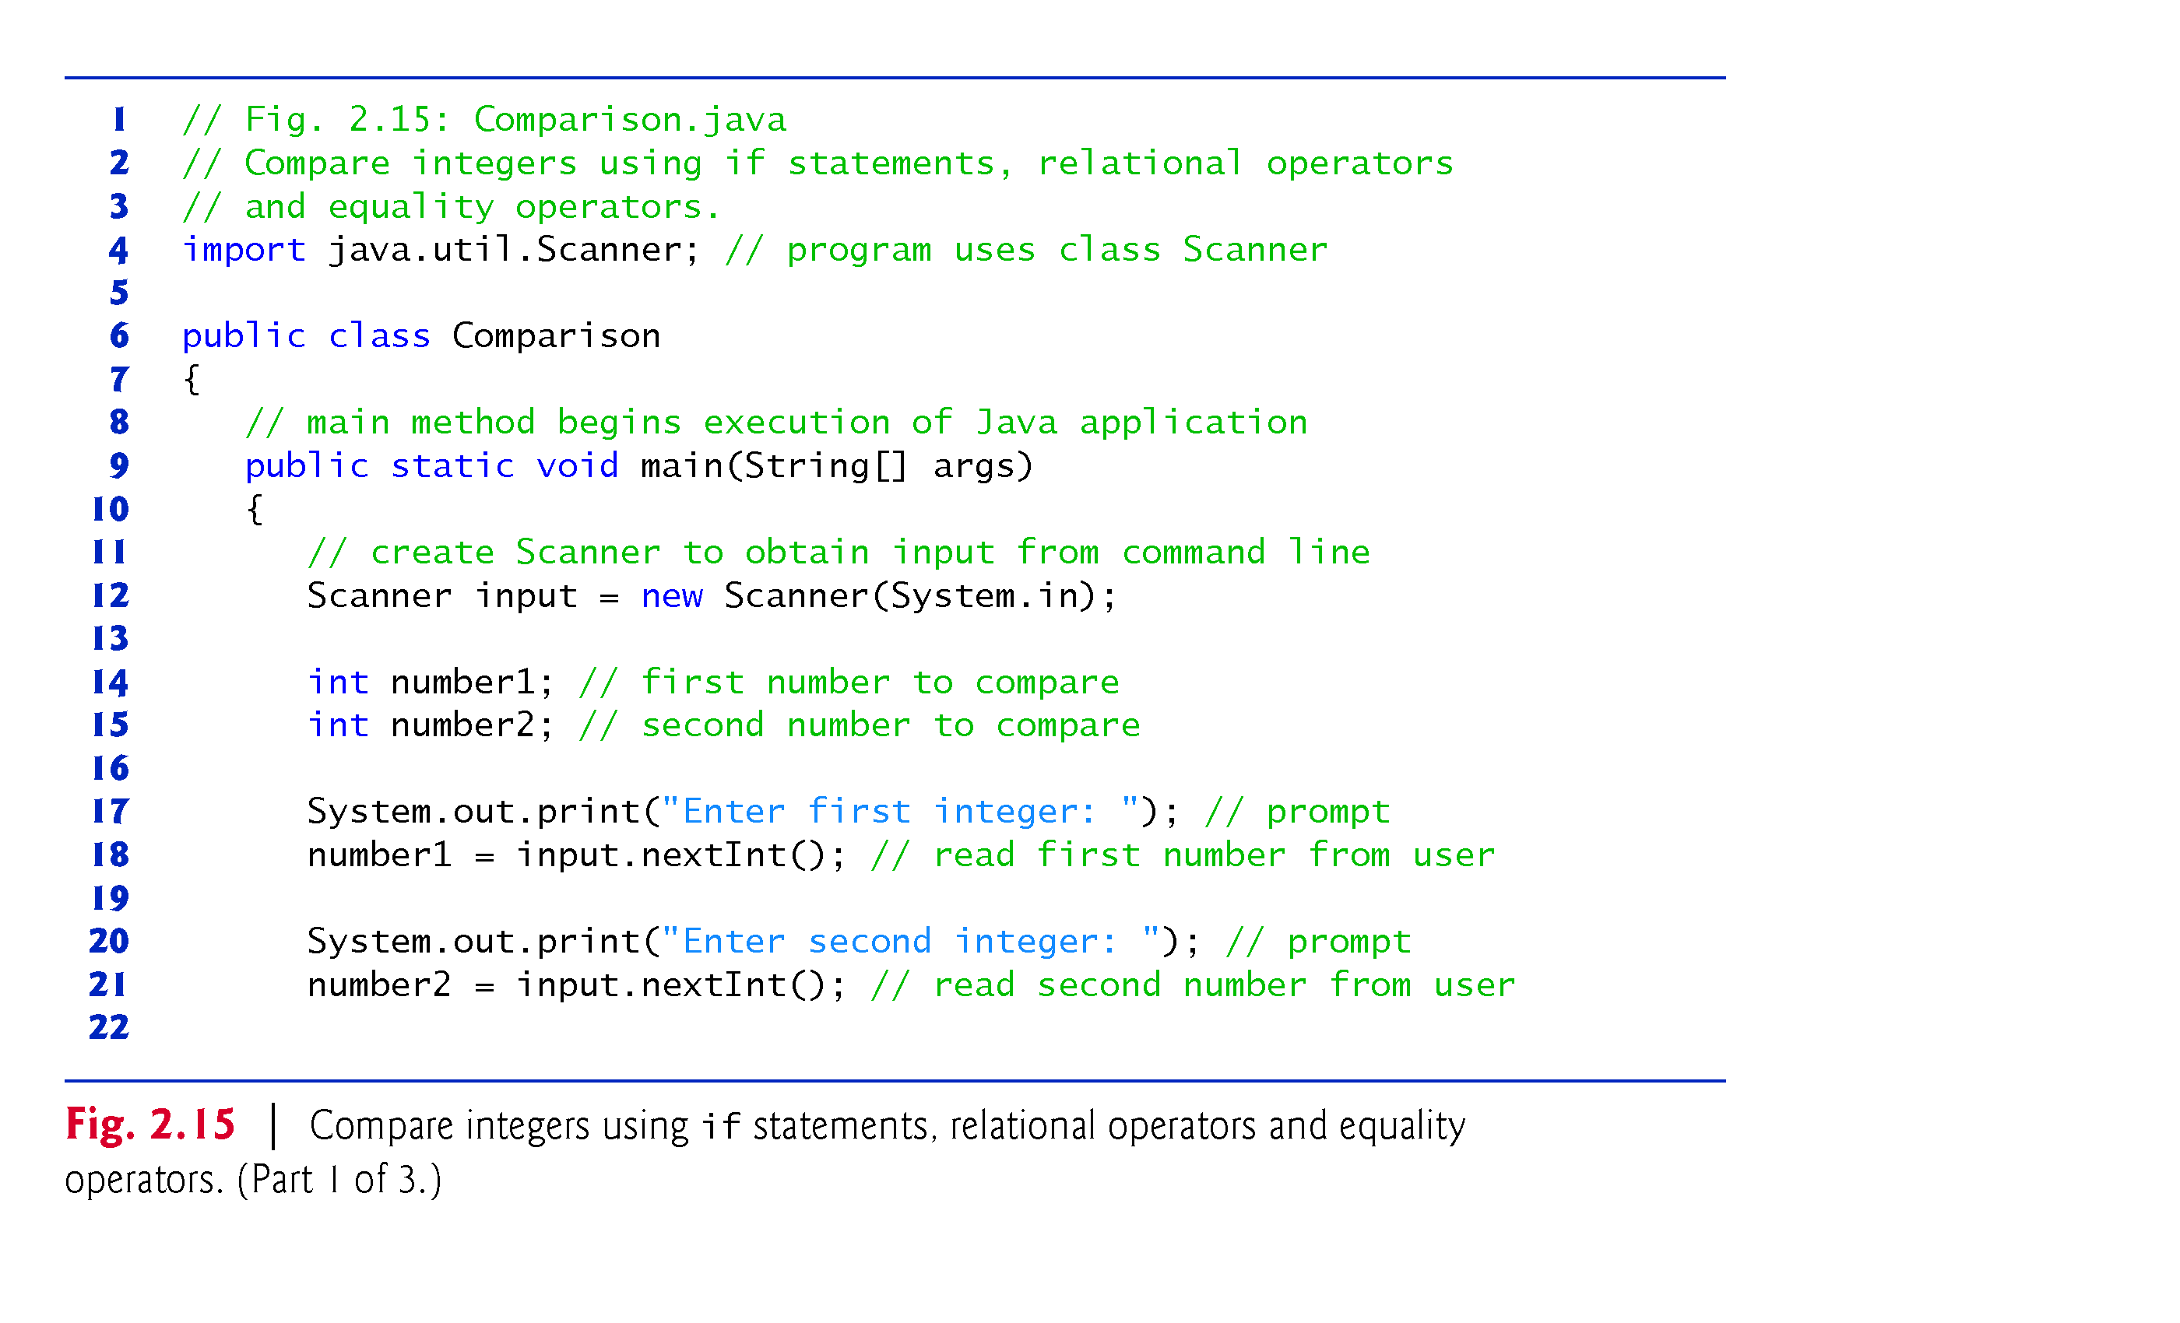
© Copyright 1992-2015 by Pearson Education, Inc. All Rights Reserved.

Slide 24
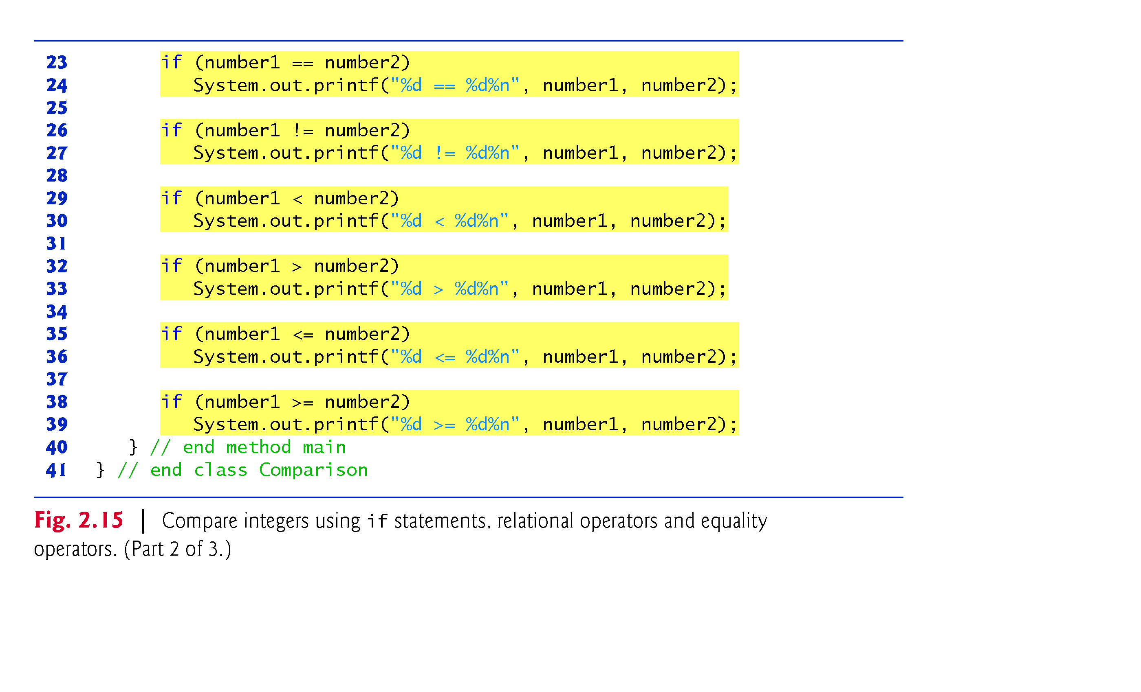
© Copyright 1992-2015 by Pearson Education, Inc. All Rights Reserved.

Slide 25
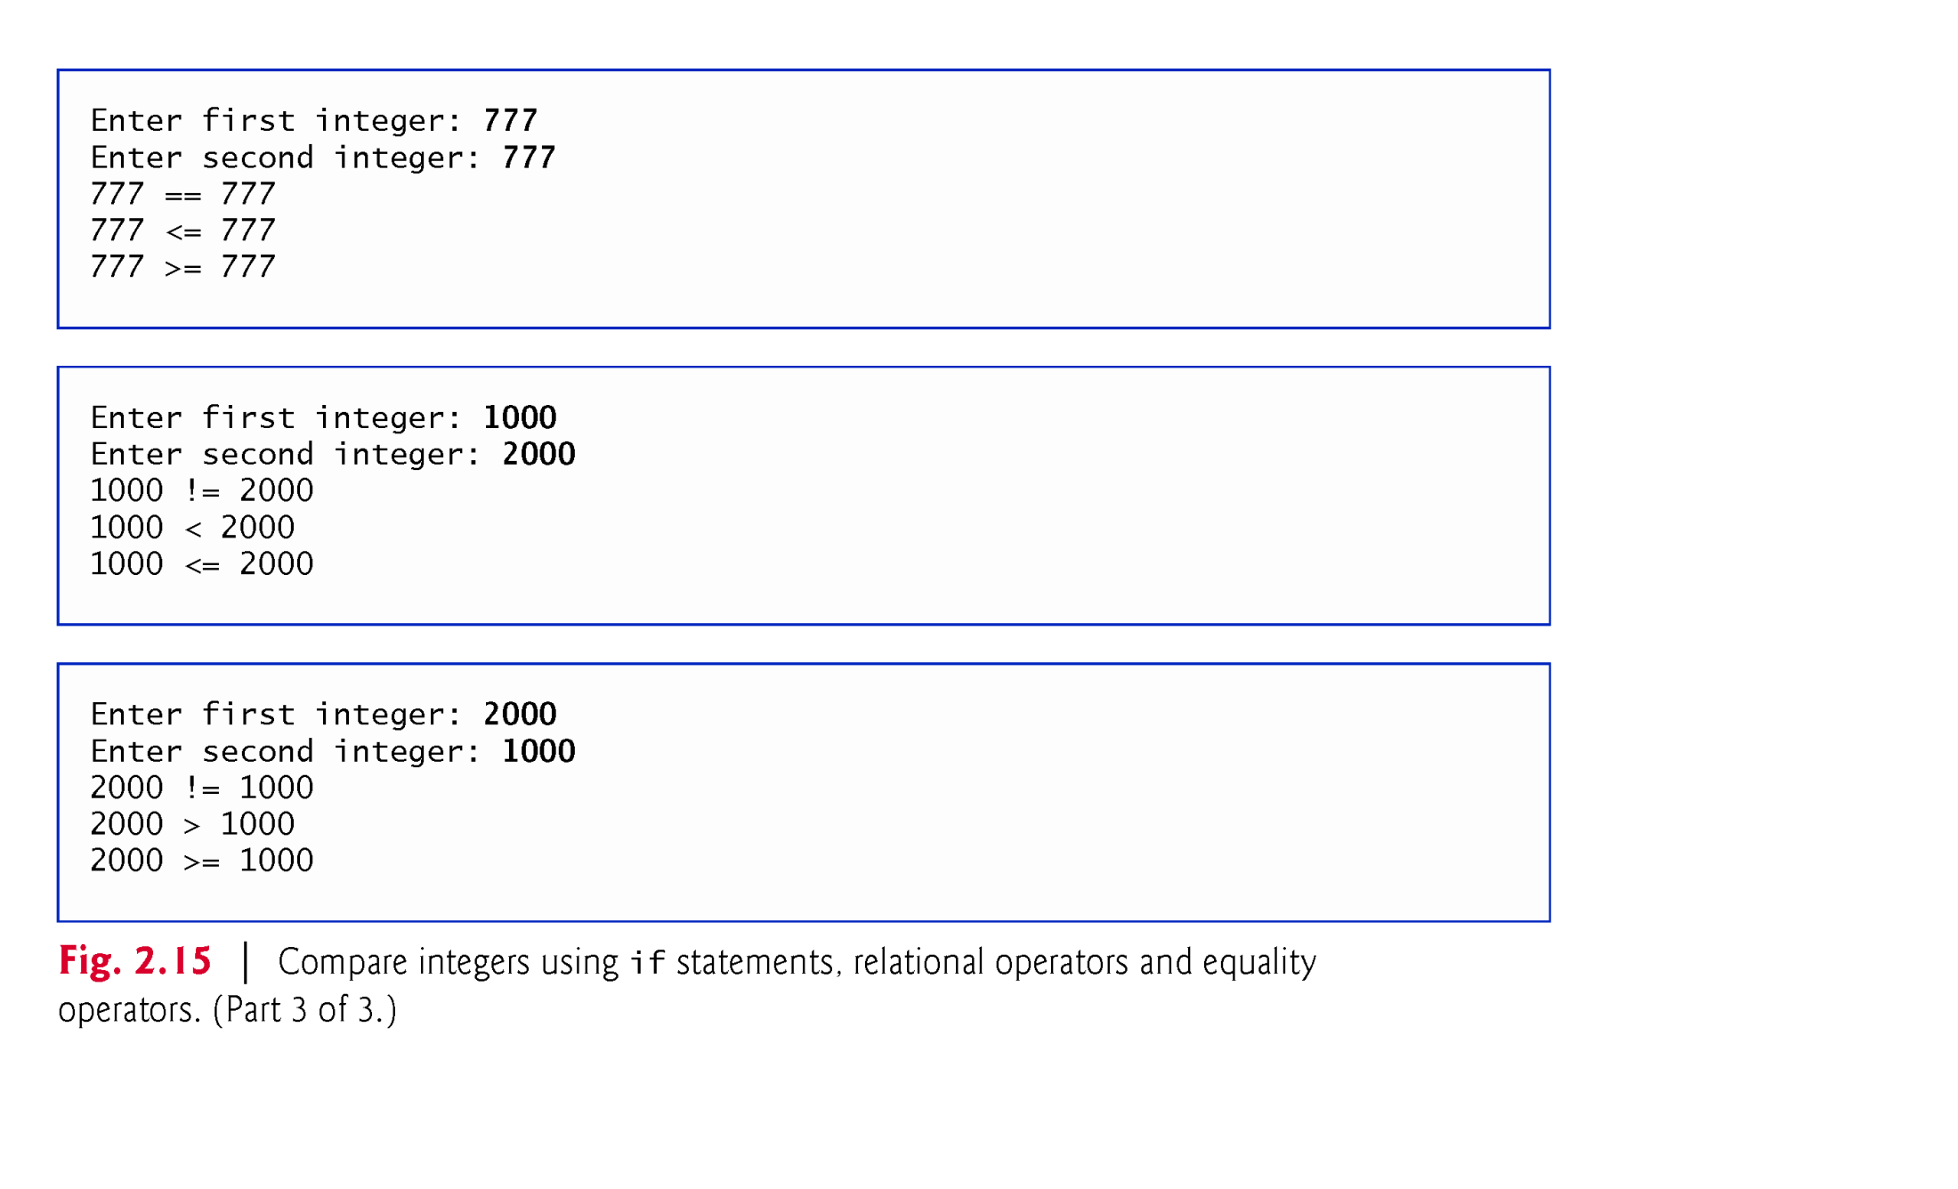
© Copyright 1992-2015 by Pearson Education, Inc. All Rights Reserved.

